Slide 1
Graduate School and Undergraduate
Research Experiences Workshop

Slide 2
Workshop Schedule
Faculty panel discussion about graduate school.
Undergraduate research experiences and how to apply for them.
Question and answer sessions on both topics.

Slide 3
Faculty Panel Discussion
about Graduate School

Slide 4
Undergraduate Research Experiences

Slide 5
Undergraduate Research Experiences
What is it?
Undergraduate research: “An inquiry or investigation conducted by an undergraduate student that makes an original intellectual or creative contribution to their discipline”
Council on Undergraduate Research
https://www.cur.org/

Slide 6
Undergraduate Research Experiences
Benefits
Lifelong professional and academic connections.
Learning the methods of your field, exploring new ways of thinking.
Strengthens candidacy for scholarships, fellowships, employment, and graduate school.

Slide 7
Undergraduate Research Experiences
Components
One-on-one work with faculty mentor(s)
Research focus in your field of study
Weekly campus-based educational enrichment activities
Presentation of research project at campus symposium

Slide 8
Undergraduate Research Experiences
Ways to Gain UR Experience
Off-campus funded programs hosted at universities
Local/government organizations that hire undergraduate research interns (e.g. US Forestry Service, the Buck Institute)
On-campus programs/departments that offer research experiences (McNair Scholars, College of Science and Engineering Technology)

Slide 9
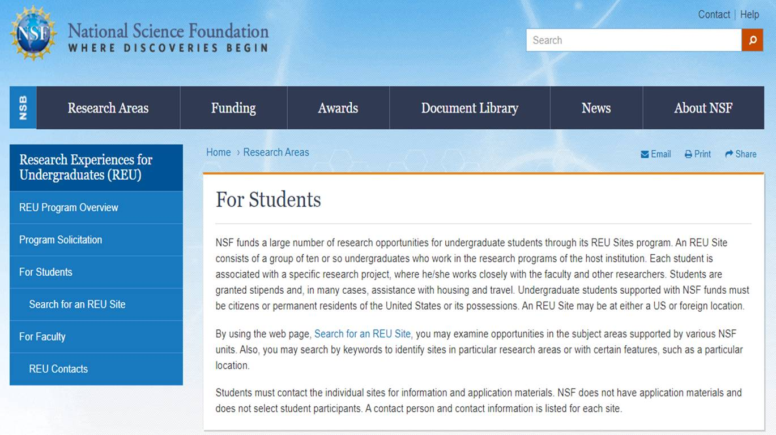
Undergraduate Research Experiences
Off-campus opportunities
National Science Foundation
Research Experiences for Undergraduates (REU)
https://www.nsf.gov/crssprgm/reu/reu_search.jsp

Slide 10
Undergraduate Research Experiences
Off-campus opportunities
National Science Foundation
Examples for Chemistry

Slide 11
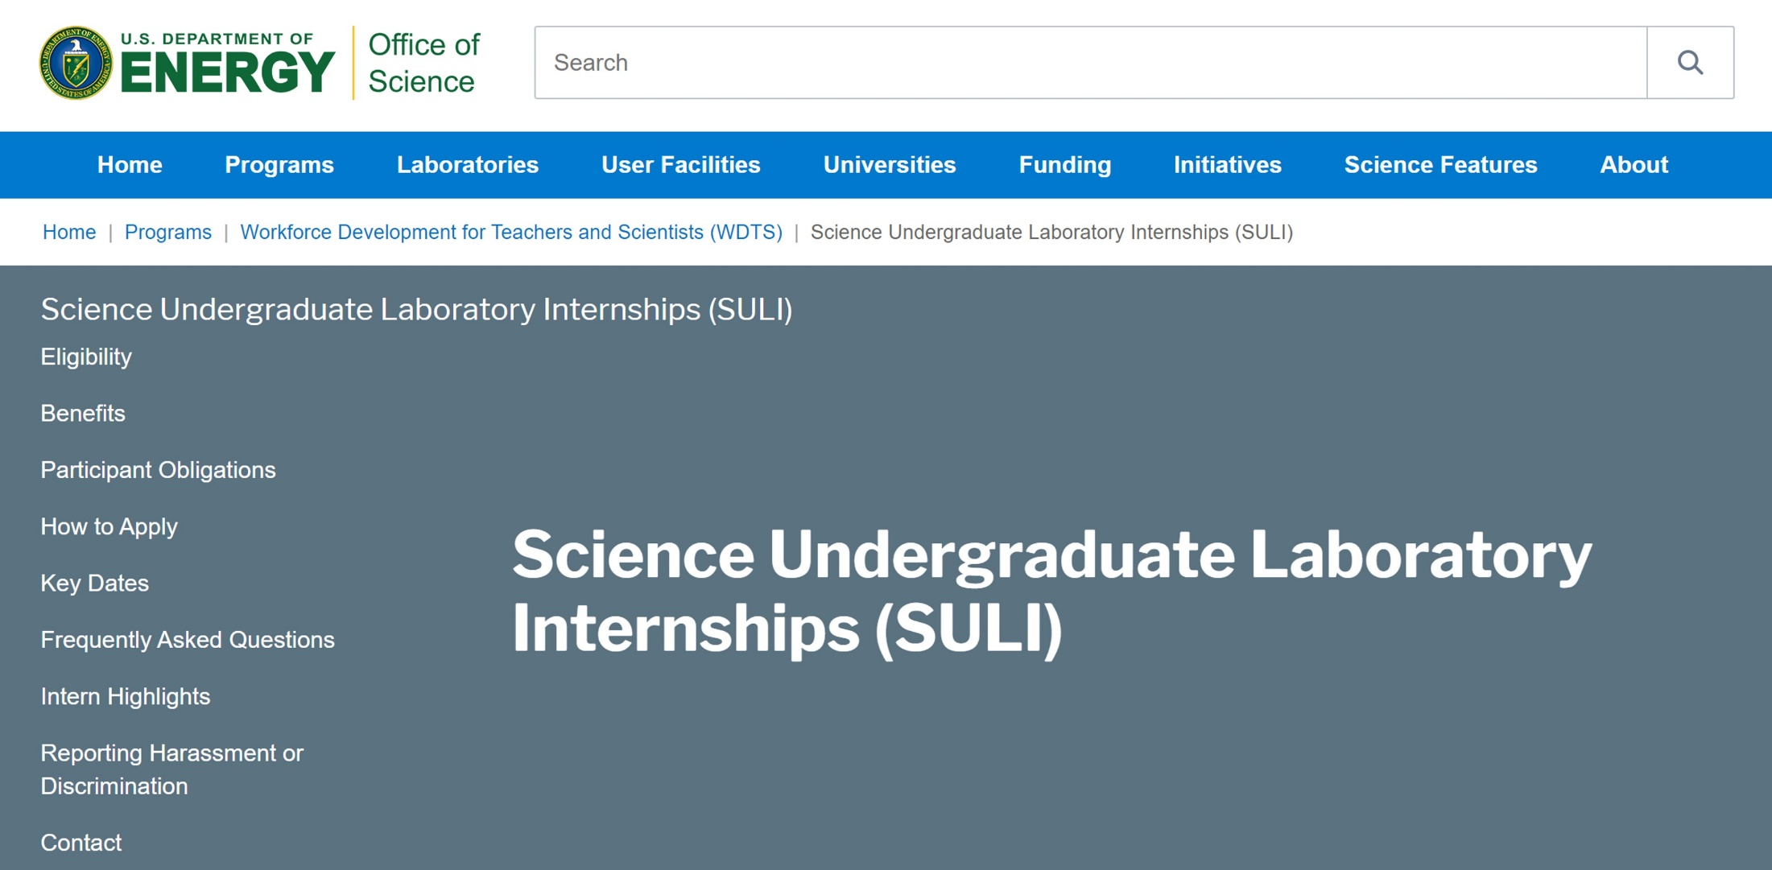
Undergraduate Research Experiences
Off-campus opportunities
https://science.osti.gov/wdts/suli

Slide 12
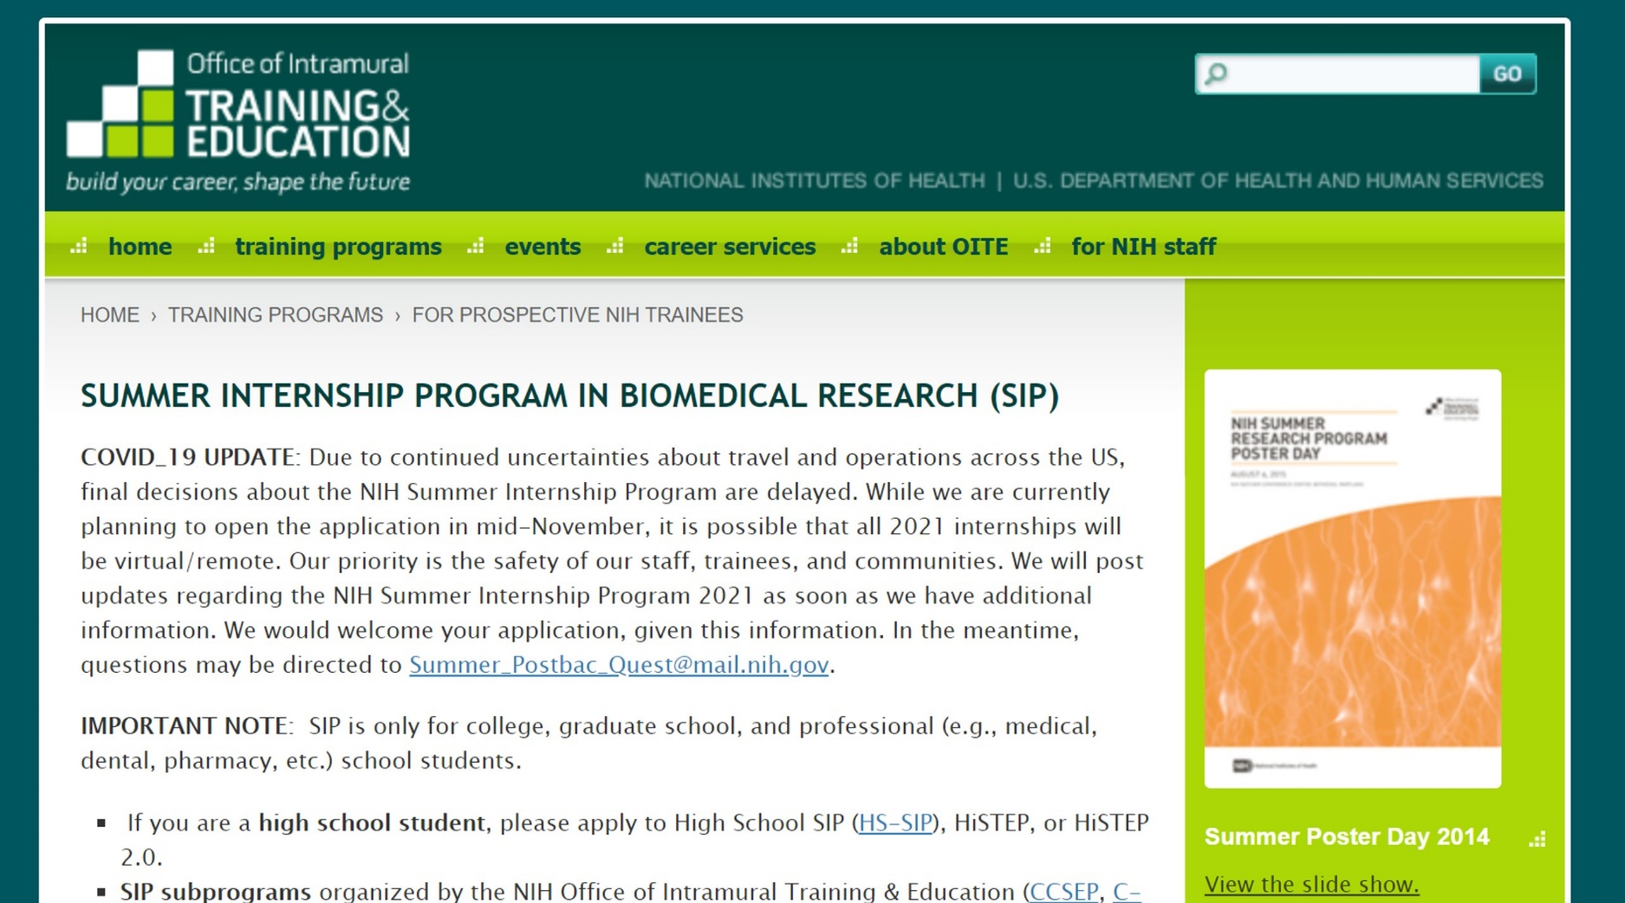
Undergraduate Research Experiences
Off-campus opportunities
https://www.training.nih.gov/programs/sip

Slide 13
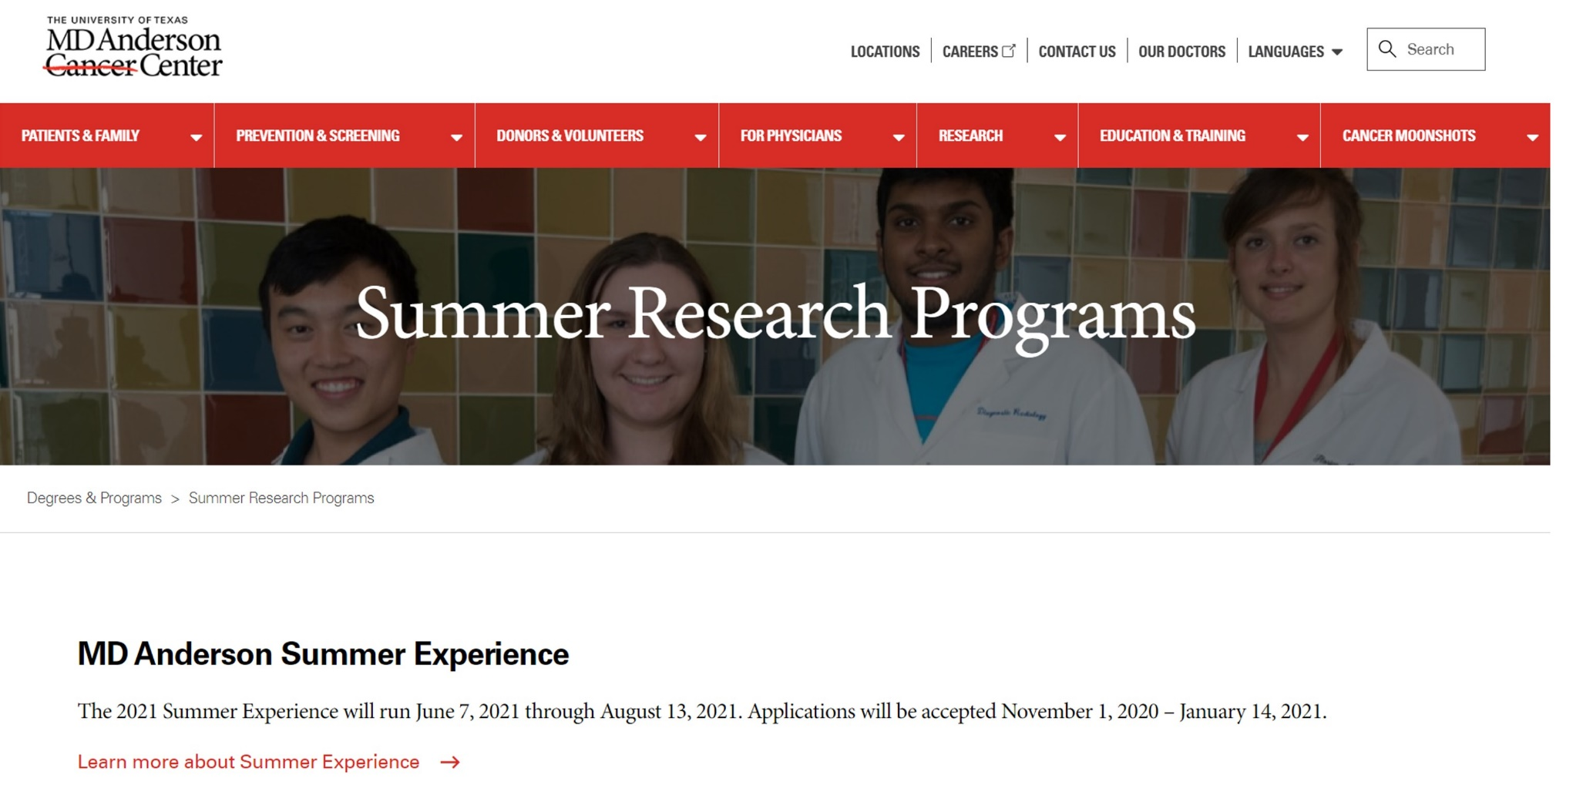
Undergraduate Research Experiences
Off-campus opportunities
https://www.mdanderson.org/education-training/degrees-programs/summer-research-programs.html

Slide 14
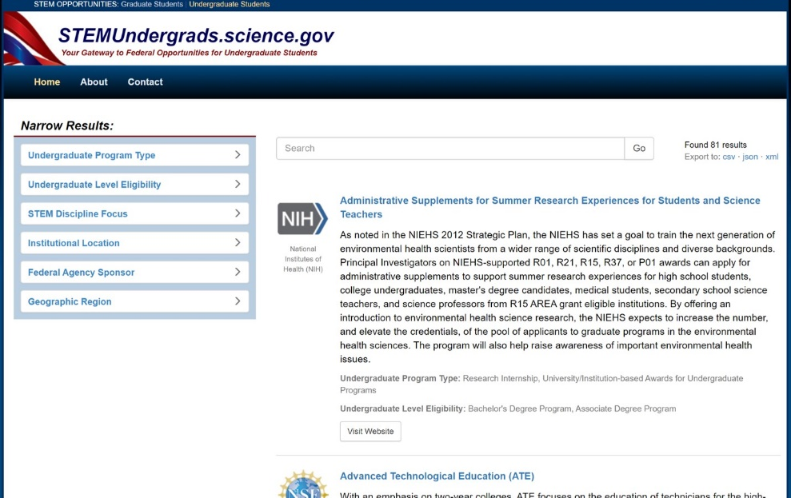
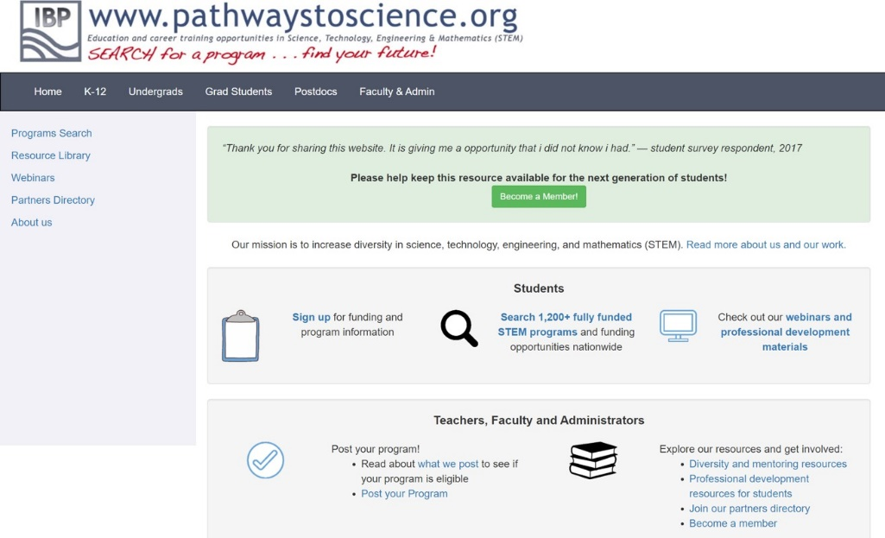
Undergraduate Research Experiences
Other resources to find opportunities:
STEMUndergrads.science.gov
Your Gateway to Federal Opportunities for Undergraduate Students
Institute for Broadening Participation
https://stemundergrads.science.gov/
https://www.pathwaystoscience.org/index.aspx

Slide 15
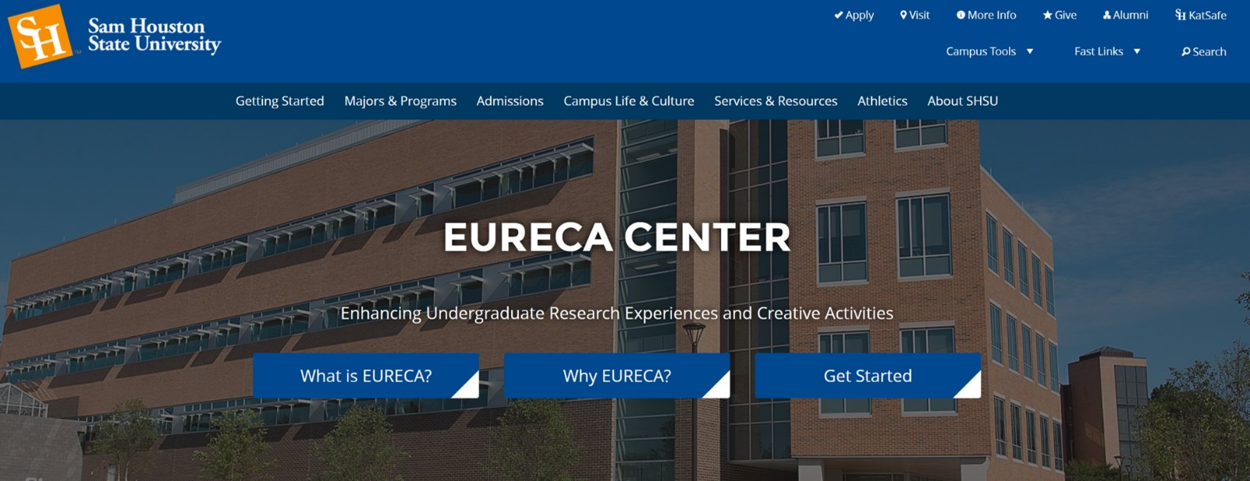
Undergraduate Research Experiences
On-campus opportunities
https://www.shsu.edu/centers/eureca/

Slide 16
Undergraduate Research Experiences
how to apply
Eligibility
Can start as early as freshman year (earlier the better prepared for more complex research in the following years).
Academics are often taken into consideration.
It can depend on the complexity of the project.

Slide 17
Undergraduate Research Experiences
how to apply
Application Elements
Application form
Copies of transcripts
Letters of recommendation
Statement of purpose and/or statement of research interests and goals
CV/Résumé

Slide 18
Undergraduate Research Experiences
how to apply
Application Elements
Letters of recommendation
Faculty in your undergrad major or related to graduate school major preferred.
The best recommenders can say the most positive, specific things about your abilities as a student and/or researcher.
Request letters about a month in advance.

Slide 19
Undergraduate Research Experiences
how to apply
Application Elements
Statement of Purpose
Include the specific research area in which you would like to work, and your future professional goals.
You may indicate whether you have particular experiences that qualify you to undertake such research, considering personal experiences, prior research experience in the field, lab, or work experience, and related course work.
Include any information that may aid the selection committee in evaluating your preparation, potential, and aptitude.

Slide 20
Q & A from Students

